Slide 1
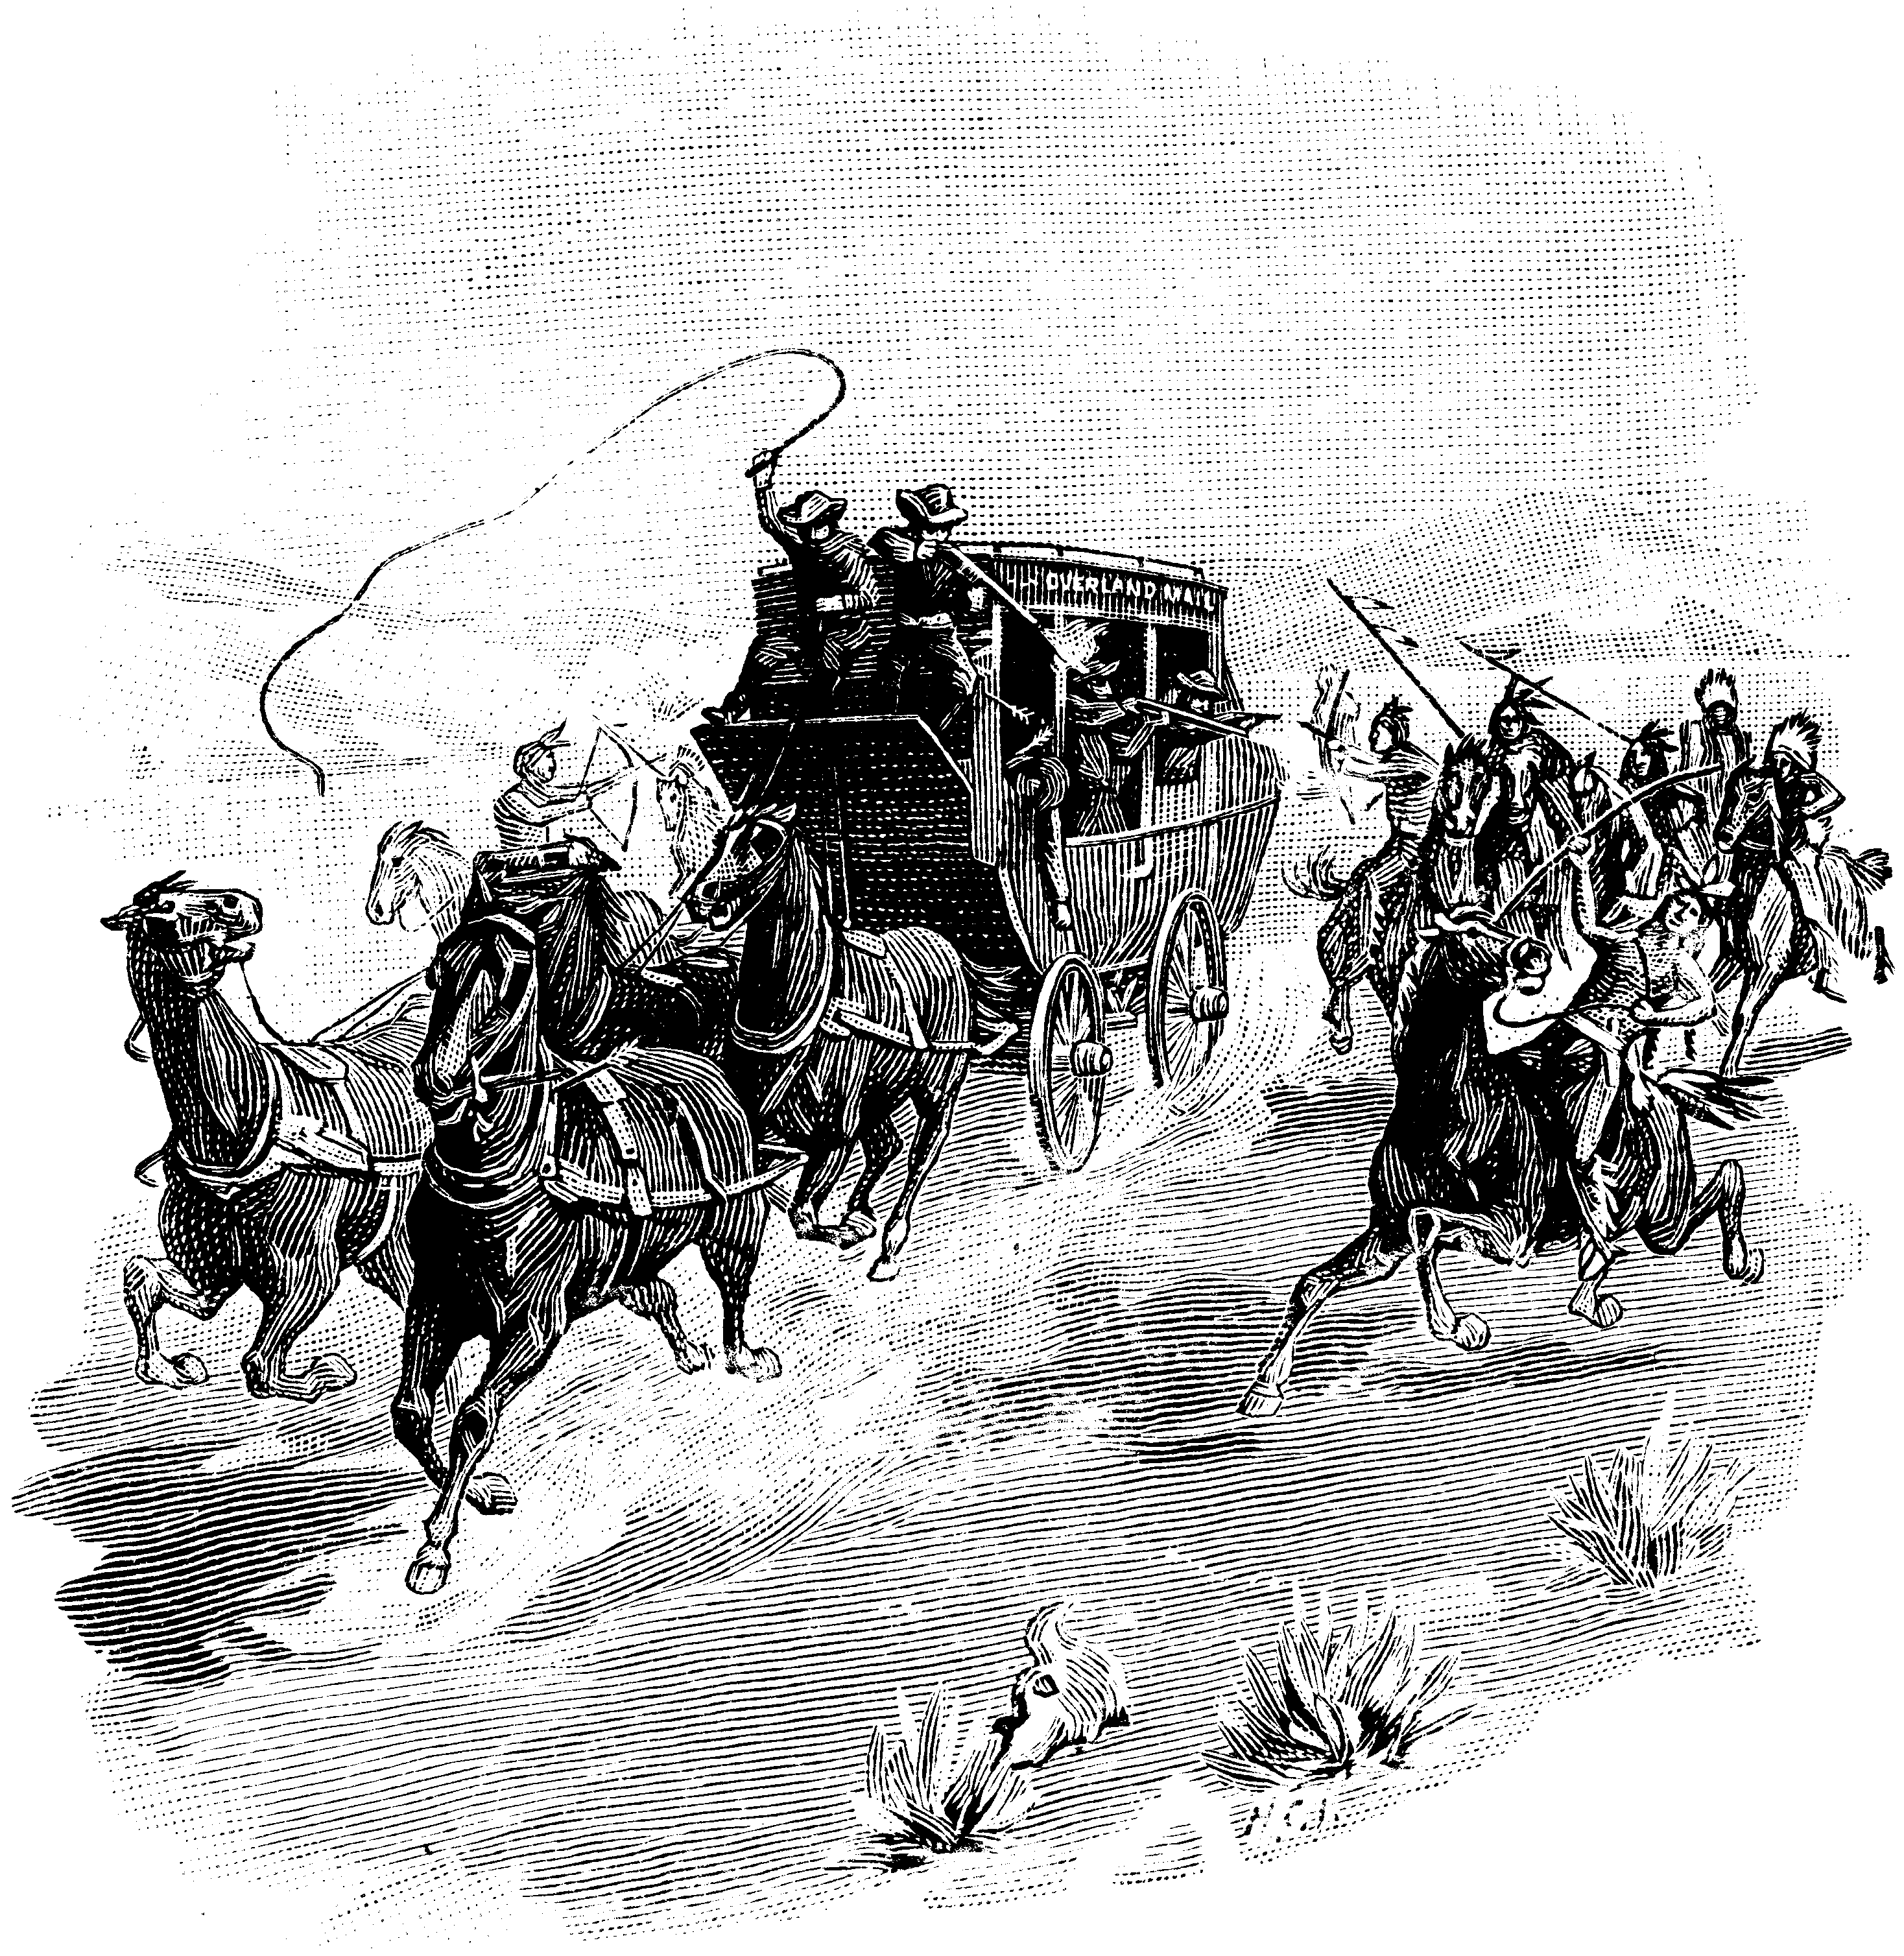

Slide 2
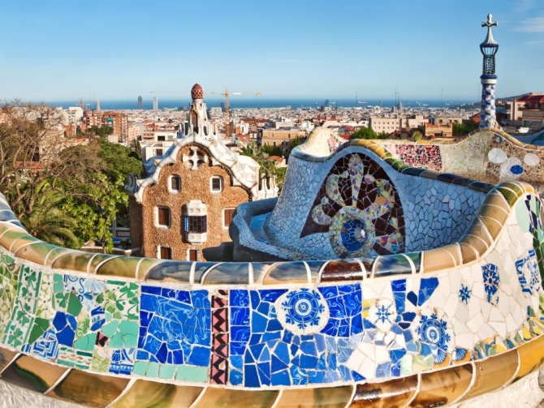
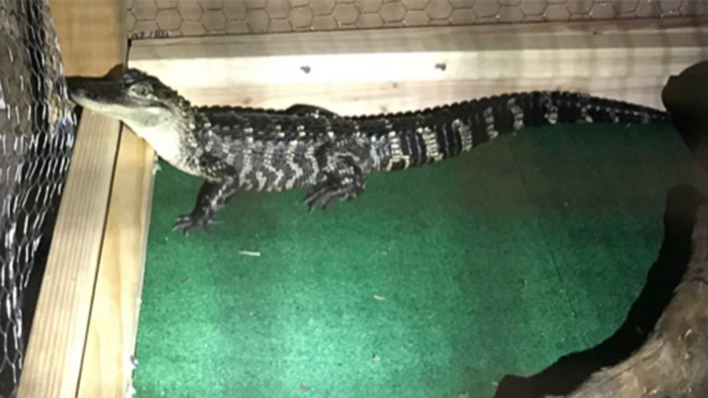
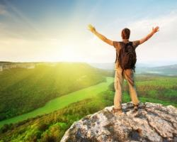
Shotgun
Tekst + musik: Goerge Ezra
1 af 5
Home grown alligator, see you later
Gotta hit the road, gotta hit the road
The sun and change in the atmosphere, architecture unfamiliar
I could get used to this
Time flies by in the yellow and green
Stick around and you’ll see what I mean
There’s a mountain top that I’m dreaming of
If you need me, you know where I’ll be

Slide 3
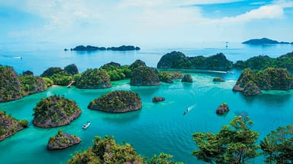
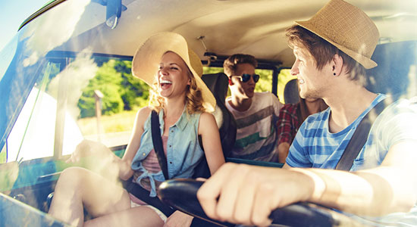
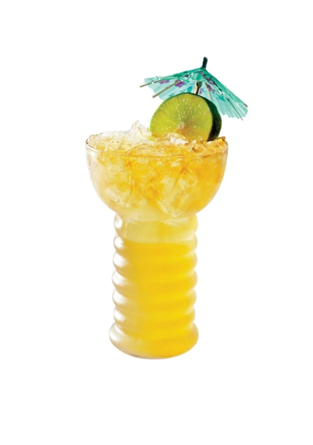
2 af 5
I’ll be riding shotgun underneath the hot sun
Feeling like a someone
I’ll be riding shotgun underneath the hot sun
Feeling like a someone
Well, South of the Equator, navigator
Gotta hit the road, gotta hit the road
And deep sea diving round the clock, bikini bottoms, lager tops
I could get used to this

Slide 4
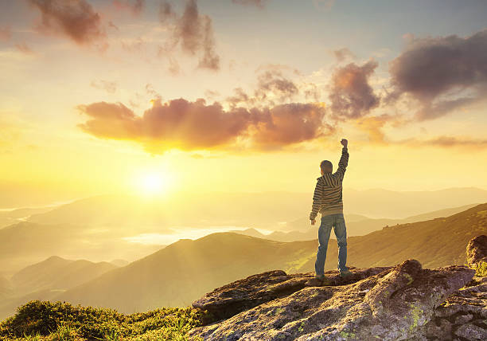
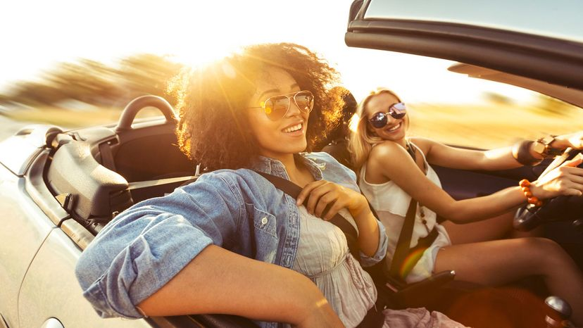
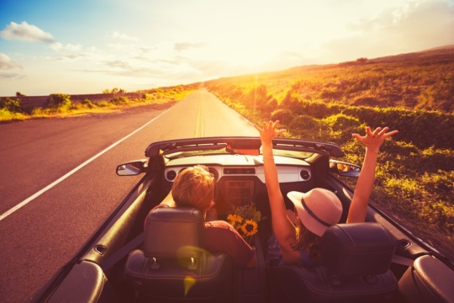
3 af 5
Time flies by in the yellow and green
Stick around and you’ll see what I mean
There’s a mountain top that I’m dreaming of
If you need me, you know where I’ll be
I’ll be riding shotgun underneath the hot sun
Feeling like a someone
I’ll be riding shotgun underneath the hot sun
Feeling like a someone

Slide 5
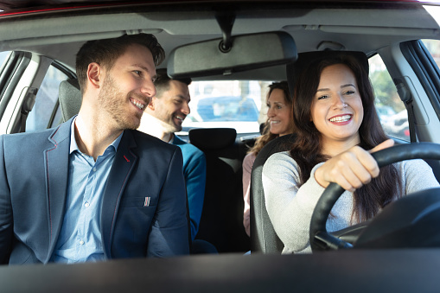
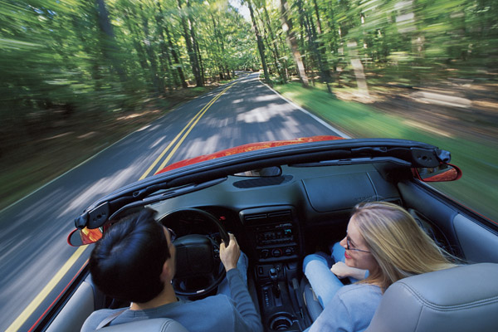
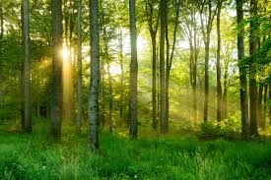
4 af 5
We got two in the front, two in the back
Sailing along and we don’t look back
Back, back, back-back-back-back
Time flies by in the yellow and green
Stick around and you’ll see what I mean
There’s a mountain top that I’m dreaming of
If you need me, you know where I’ll be

Slide 6
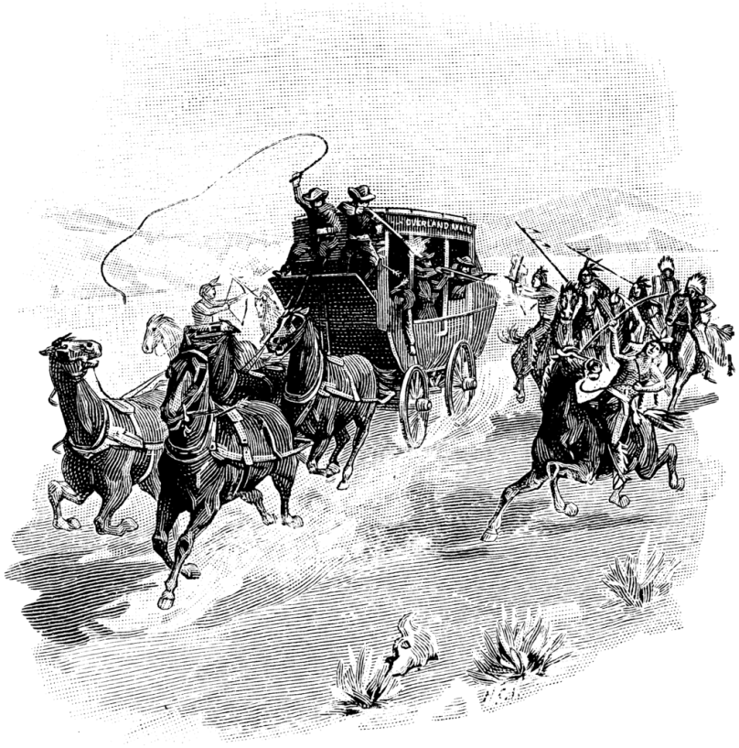
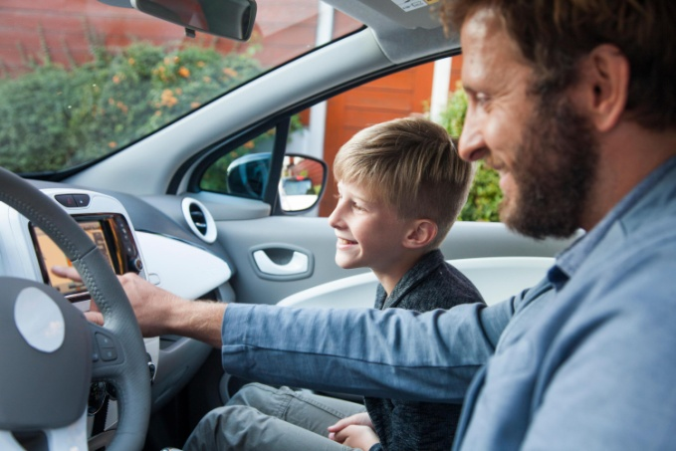
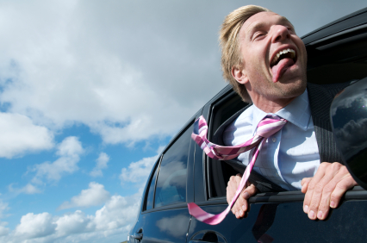
5 af 5
I’ll be riding shotgun underneath the hot sun
Feeling like a someone
I’ll be riding shotgun underneath the hot sun
Feeling like a someone
I’ll be riding shotgun underneath the hot sun
Feeling like a someone
I’ll be riding shotgun underneath the hot sun
Feeling like a someone, someone, someone, some

